Slide 1
K-means and Self-Organizing Maps on Topological Preservation and their Performance on Increased Number of Clusters and Nodes.

Slide 2
Points
Motivation
Problem Statement
Related Work and Background Material
Approach
Experiment set-up (including Metrics, Benchmarks, Data collection)
Results and Discussion
Contributions and Conclusions

Slide 3
Motivation
Compare two popular clustering algorithms, Self-Organizing Maps (SOMs) and K-means:
Ability to group similar objects or data points together. Clustering is an important technique in machine learning and data analysis, and is used in a wide range of applications such as customer segmentation, image processing, and natural language processing.
Gain insights into the strengths and weaknesses, and their performance for different types of datasets and applications.
Contribute to a broader understanding of clustering algorithms and inform the choice of algorithm for different use cases.

Slide 4
Problem Statement
To demonstrate this difference between the two algorithms in regards to topology preservation.
To investigate the effect of increasing the number of output SOM nodes and the number of K-means clusters in relation to their clustering performance on the Fisher's Iris data set.

Slide 5
Related Work
Sueli A. Mingoti and Joab O. Lima. “Comparing SOM neural network with Fuzzy c-means, K-means and traditional hierarchical clustering algorithms”.European Journal of Operational Research, Volume 174, Issue 3, 2006, Pages 1742-1759, ISSN 0377-2217.
Compares the performance of SOM neural network with traditional hierarchical clustering algorithms such as Fuzzy c-means and K-means
Chen, Y., Qin, B., Liu, T., Liu, Y., &amp; Li, S. “The comparison of SOM and K-means for text clustering. Computer and Information Science”. 3(2). 2010.
compares the effectiveness of SOM and K-means algorithms for text clustering, using a variety of evaluation metrics and datasets, and provides insights into the strengths and weaknesses of each method.

Slide 6
What are Clustering Algorithms?
Group similar objects or data points together based on their attributes, without prior knowledge of the groupings or labels.
Important for data exploration, pre-processing, segmentation, and business intelligence.
Can explore the underlying structure of a dataset, reduce complexity, manage and analyze data, and inform decision-making in various applications such as customer segmentation and product recommendation systems.

Slide 7
Approach
The project utilizes MATLAB R2022b to test the performance of K-means and Self-Organizing Maps (SOMs) algorithms.
The performance of K-means is tested with different values of clusters, k, while the performance of SOMs is tested with different sizes of square dimensions.
The K-means approach is tested with k = 2, 3, 4,..., 100, while the SOMs approach is tested with square dimensions of 4, 9, 16,..., 100.
All elements within each cluster are given shared labels (species), and the new labels are compared against their originals to evaluate the models' accuracy.

Slide 8
Experiment set-up: Data & Measurement
Data
The data set used in the project is the Fisher's Iris data set, which contains 150 iris specimens from 3 species (setosa, versicolor, virginica), with 50 specimens from each species.
Each specimen in the data set has 4 features that the algorithms may utilize for clustering.
Measurement
Graphs of the models' accuracy across the different numbers of clusters/nodes and the number of elements per cluster/node ratio were plotted.

Slide 9
Experiment set-up: K-means
Starts by randomly selecting K number of points as centroids
Assign each point to their nearest centroid by calculating the Euclidean distance.
After all points are assigned to centroids, the mean of the data points belonging to each cluster is computed and used to update the centroid of that cluster
Loop and reassign points to their nearest centroid while updating the centroids every iteration. (100)

Slide 11
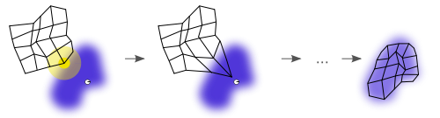
Experiment Setup: SOM
selforgmap() & train() library functions from MATLAB was used to implement the SOM algorithm.
Within each node, the most occurring species label was selected to represent the node as a whole.
Record accuracy by comparing frequencies of correct node labels in regards to each element's label.
Calculate estimated distribution ratio of elements in nodes at the given dimensions.
Tested with square dimensions of 4, 9, 16, … to 100.

Slide 12
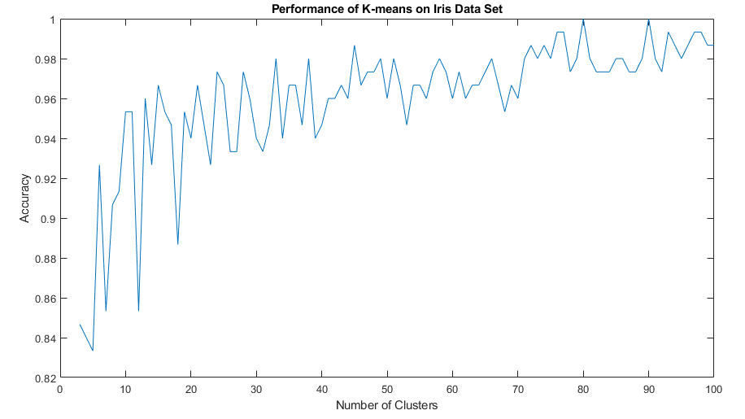
Results and Discussion: K-means Graphs

Slide 13
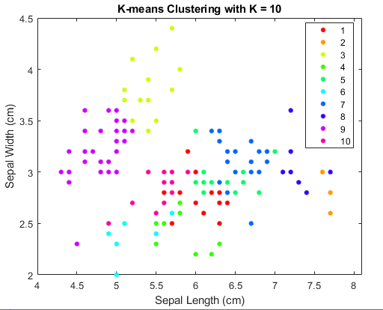
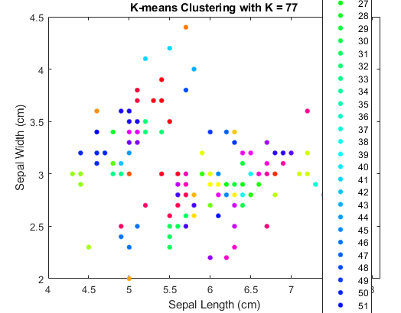

Slide 14
Results and Discussion: K-means
Increasing the number of clusters in the iris dataset leads to more accurate classification of the data points.
Testing the number of clusters from 3 to 100 reveals a steady increase in accuracy from 84.67% to 100%.
However, beyond a certain point, increasing the number of clusters may result in overfitting and smaller clusters that are harder to draw meaningful conclusions from.
A balance between accuracy and generalizability can be achieved by selecting a meaningful K value, such as K=10, which has an accuracy of over 95% while keeping the clustering somewhat distinguishable.

Slide 15
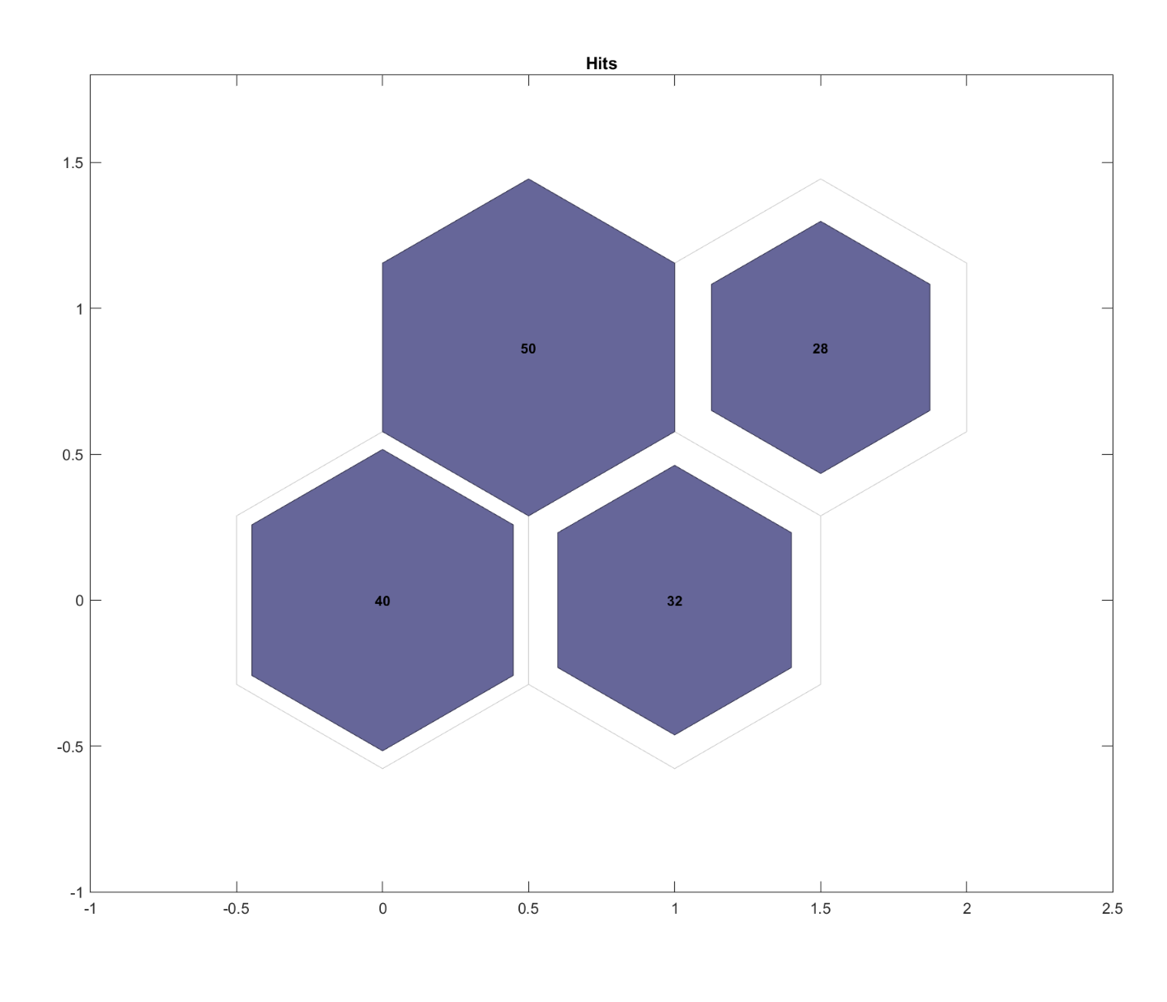
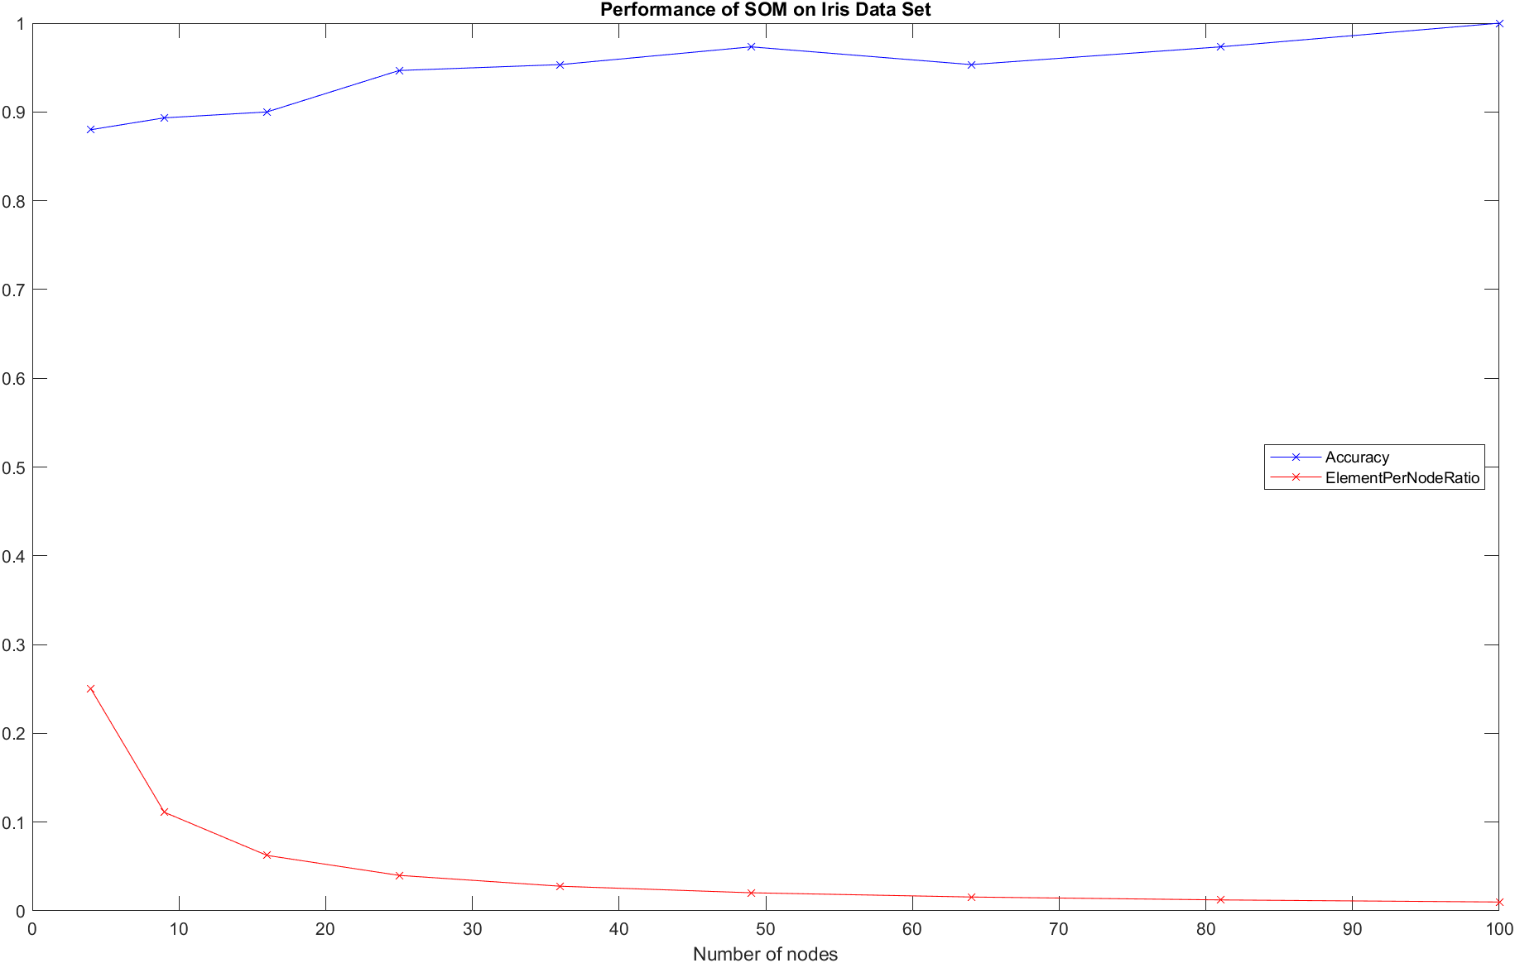
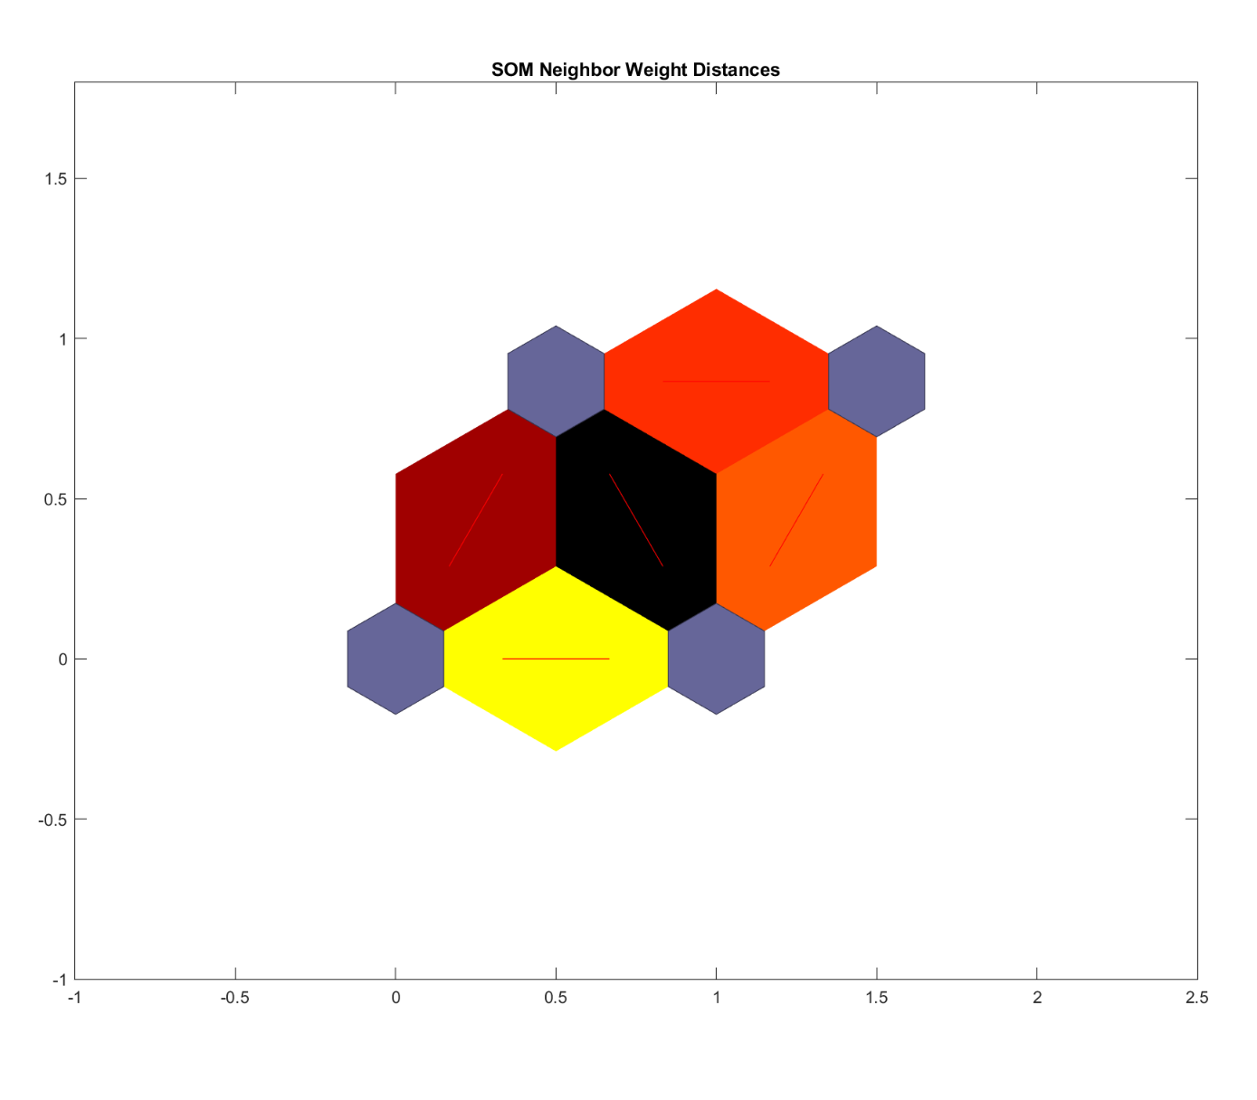
Results and Discussion: SOM Graphs
Notes:
Accuracy increases when the number of nodes increases, great start of 88% a 2-by-2.
Diminishing returns after 5-by-5 nodes and approaches 100% accuracy at 10-by-10 nodes.
At 100 nodes, each node only contains 1% of the sample size, around 1-2 elements per node. Not meaningful because elements are clustered at a near 1-to-1 grouping without relating similar elements under the same node.
Exponentially decreasing graph of the number of elements per node, distribution dropped to 4% (6 elements per node) and below starting at the dimension of 5-by-5.
At 4 nodes with an accuracy of 88% and a high element-per-node ratio of around 25%, the square dimension of a 2-by-2 seems to be the optimal setting for SOM on the iris data set.

Slide 16
Results and Discussion: SOM
Accuracy increases when the number of nodes increases, great start of 88% a 2-by-2.
Diminishing returns after 5-by-5 nodes and approaches 100% accuracy at 10-by-10 nodes.
At 100 nodes, each node only contains 1% of the sample size, around 1-2 elements per node. Not meaningful because elements are clustered at a near 1-to-1 grouping without relating similar elements under the same node.
Exponentially decreasing graph of the number of elements per node, distribution dropped to 4% (6 elements per node) and below starting at the dimension of 5-by-5.
At 4 nodes with an accuracy of 88% and a high element-per-node ratio of around 25%, the square dimension of a 2-by-2 seems to be the optimal setting for SOM on the iris data set.

Slide 17
Contributions and Conclusion
Contribution:
Demonstrate the differences between SOM and K-means clustering algorithms and their impact on the accuracy of clustering on the iris dataset
Conclusion:
Increasing the number of clusters in K-means and SOM can improve accuracy, but it's important to find the right balance between accuracy and meaningful classification.
SOM provides a 2D neighbor weight distance visualization that is topologically preserving, offering an alternative to K-means' focus on high dimensional distances.
K-means is more flexible with its number of clusters, while SOM is limited to a quad for the number of nodes.

